Slide 1
Random Forest Model
(Basic) Multiple Linear Regression
minLeafSize = 5
nTrees = 100
5 features: lon, lat, pressure, temperature, salinity
O₂ = b₁ + b₂*lon + b₃*lat + b₄*p + b₅*Θ + b₆*S_{A}

Slide 2
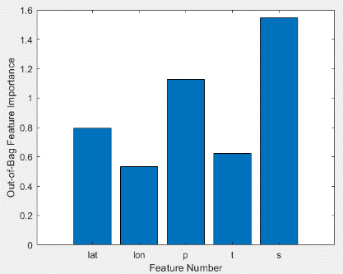
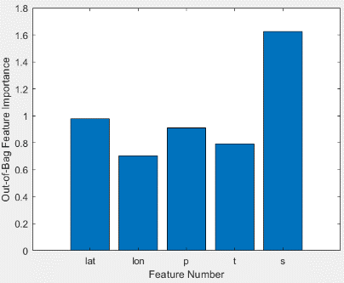
-Salinity is most powerful predictor of O₂ in the random forest -Latitude and pressure are also strong predictors -Longitude and temperature are weaker predictors
SG 659
SG 660

Slide 3
SG 659

Slide 4
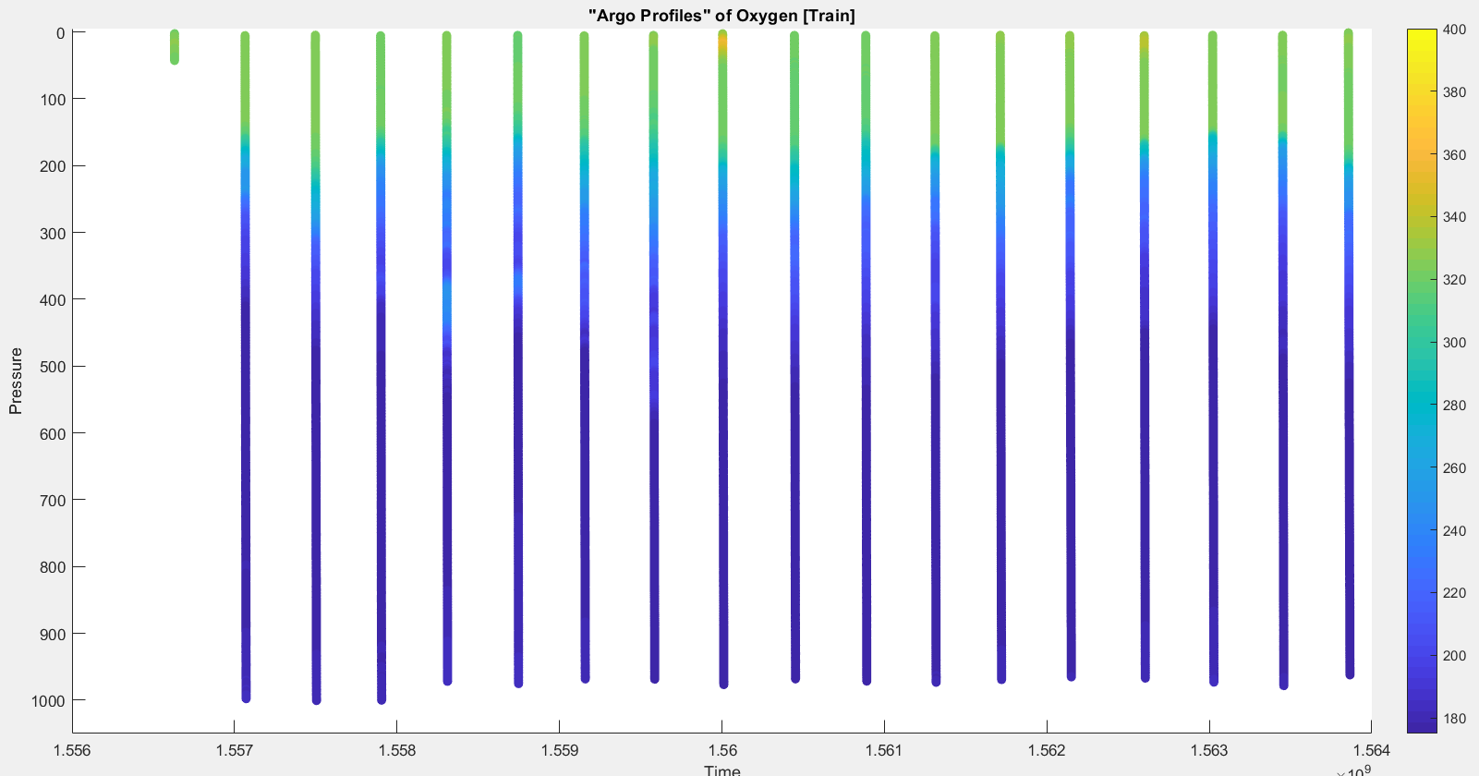

Slide 5
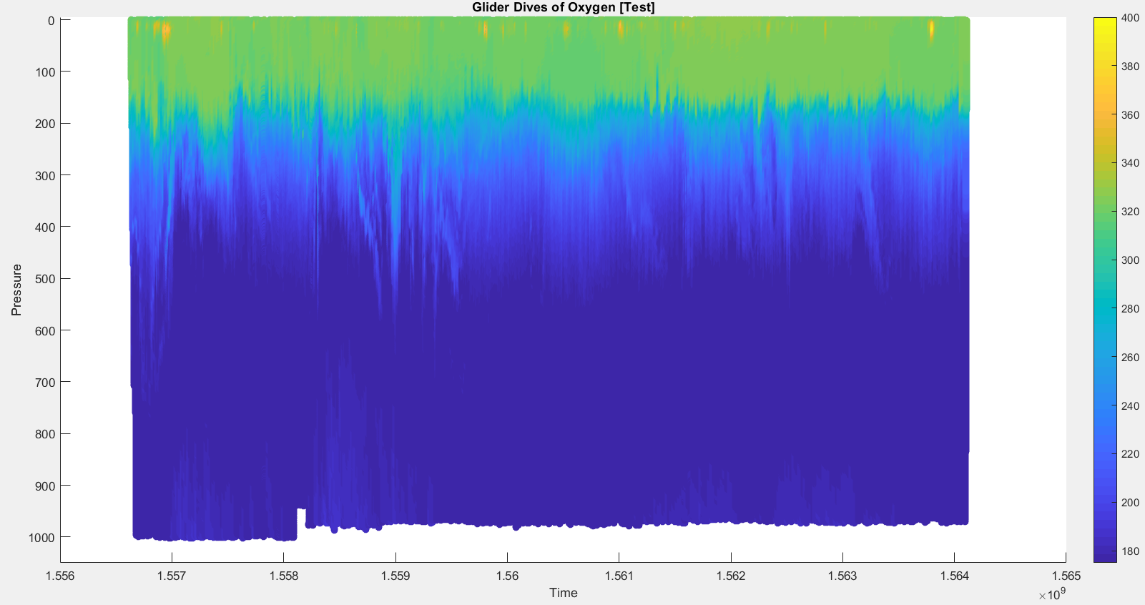

Slide 6
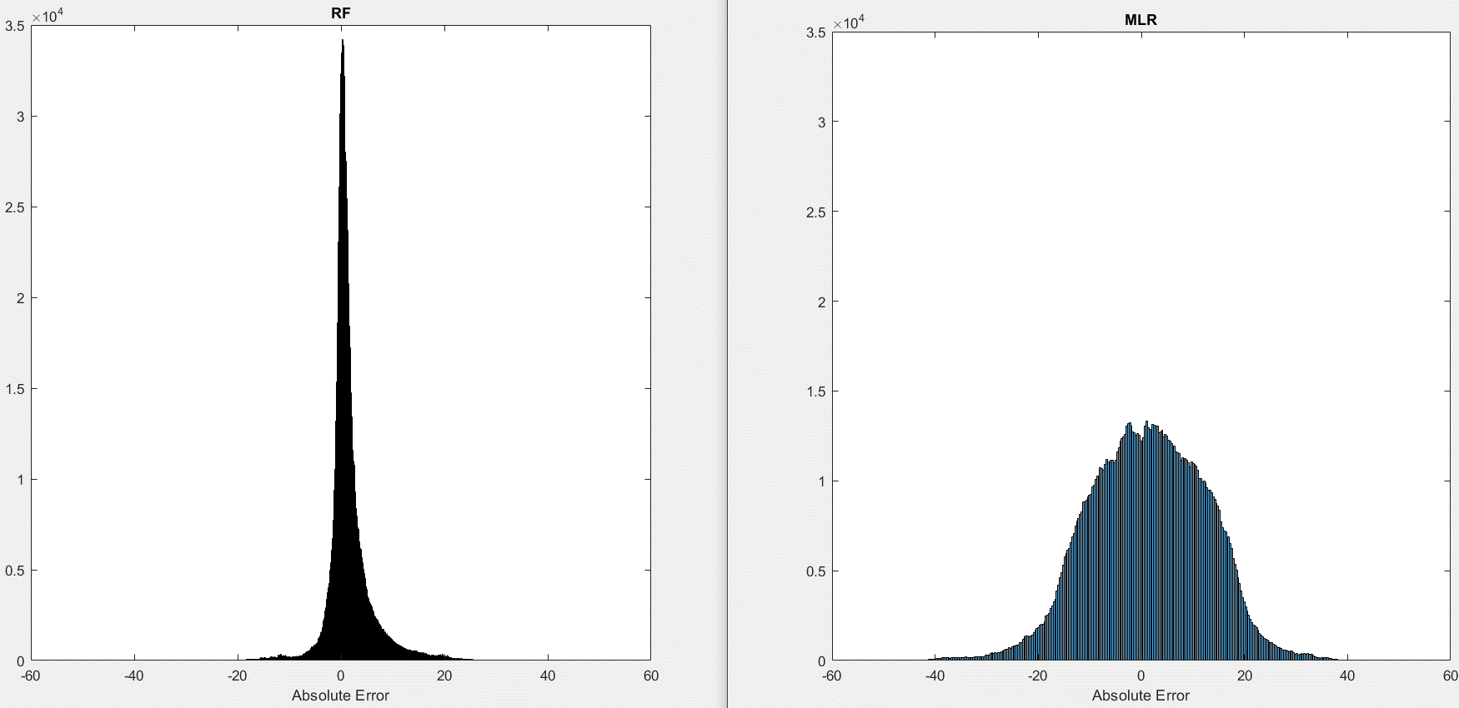
Median AE = 0.7586
Median AE = 1.4077
R²_{training} = 0.9653
Number of Points
Number of Points

Slide 7
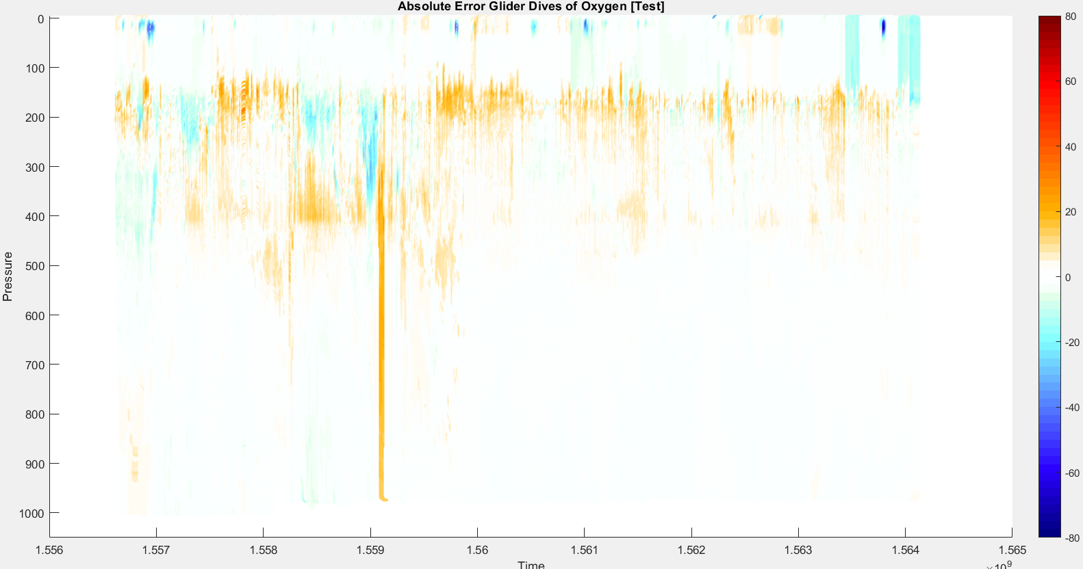
RF

Slide 8
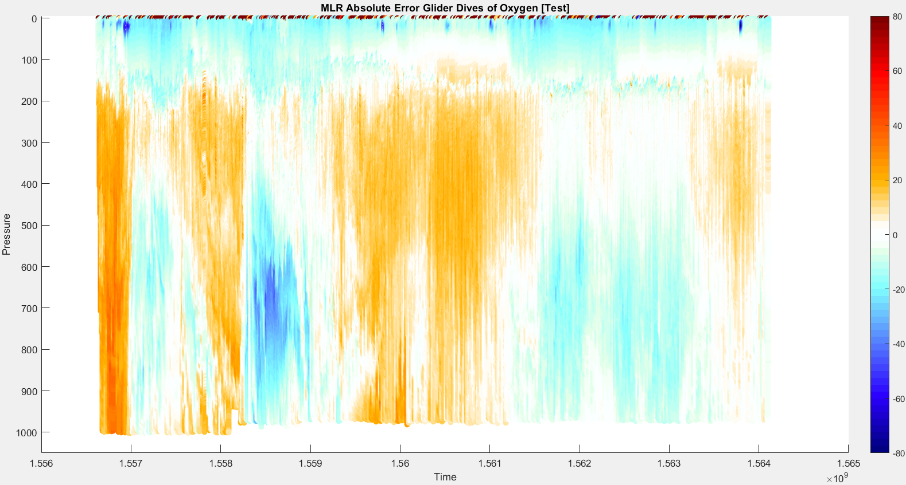

Slide 9
SG 660

Slide 10
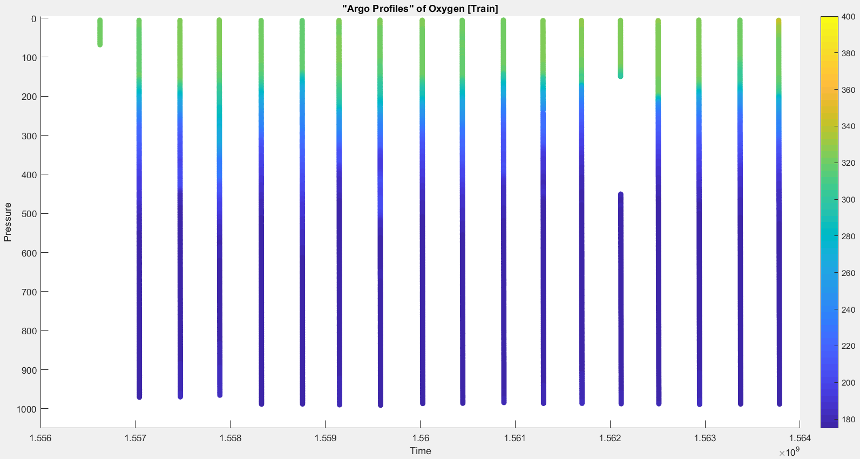

Slide 11
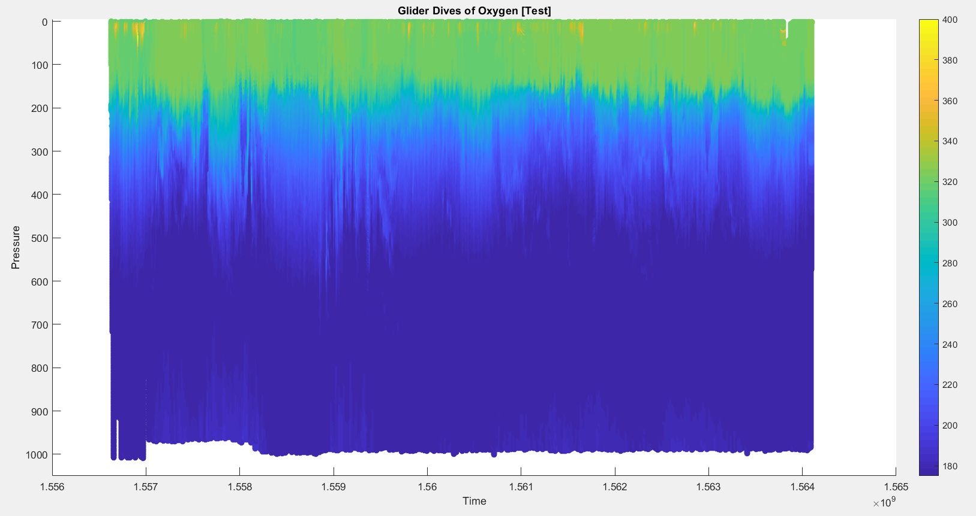

Slide 12
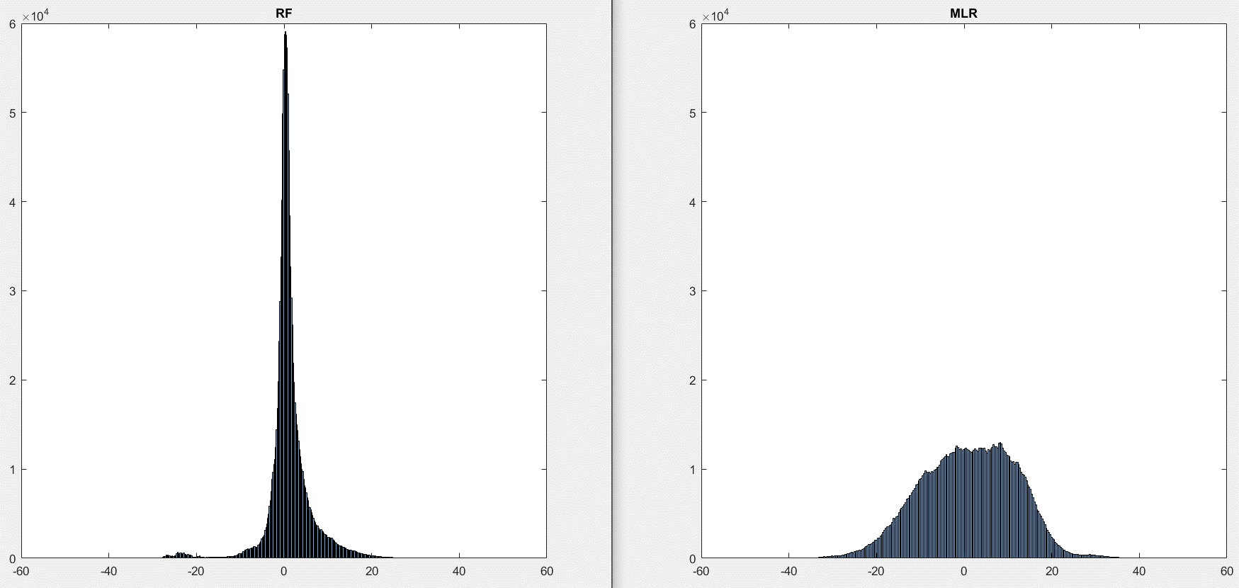
Median AE = 0.6540
Median AE = 1.4869
R²_{training} = 0.9715
Number of Points
Number of Points
Absolute Error
Absolute Error

Slide 13
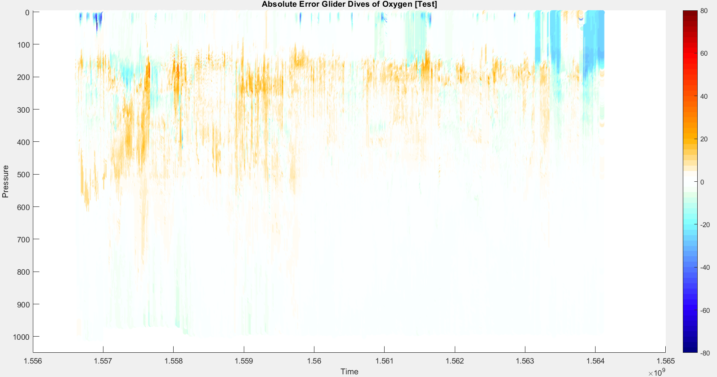
RF

Slide 14
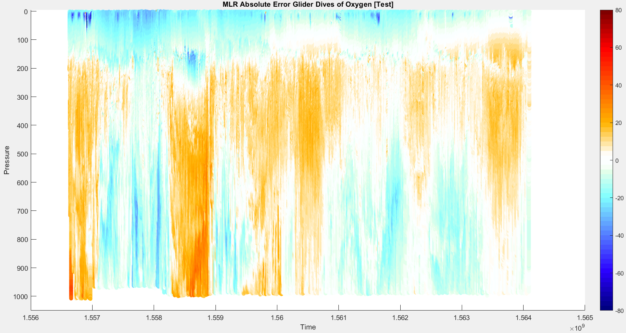

Slide 15
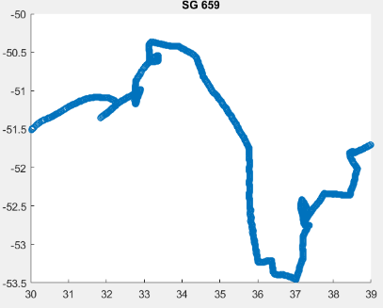
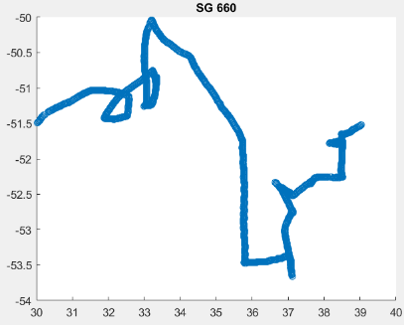
Data Distribution for Reference

Slide 16
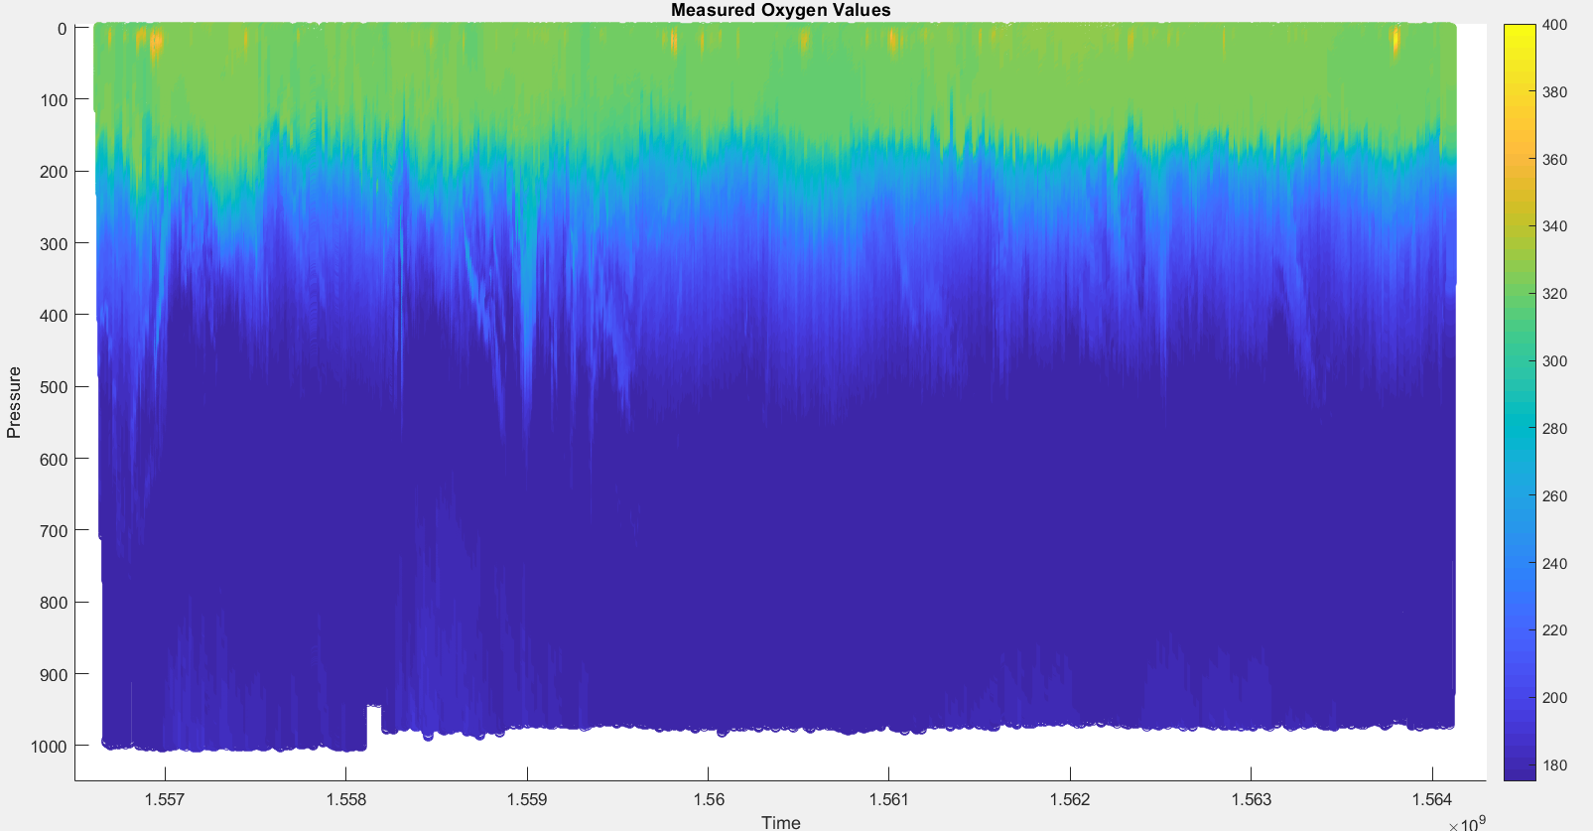
SG 659

Slide 17
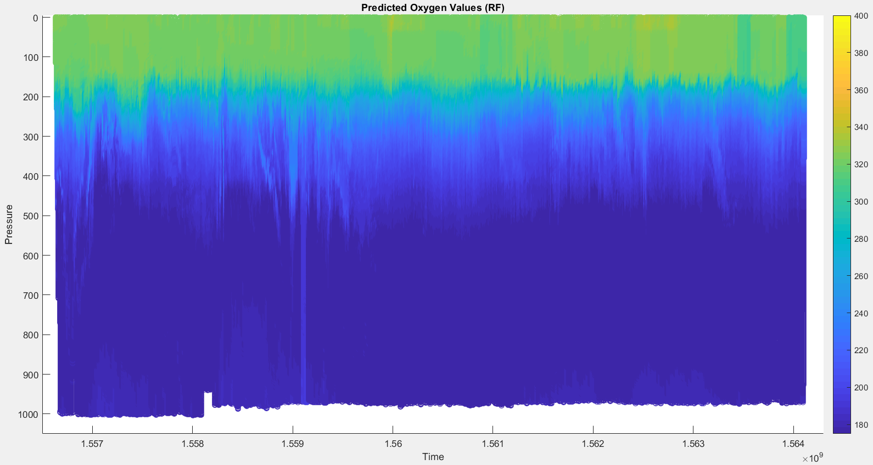
SG 659

Slide 18
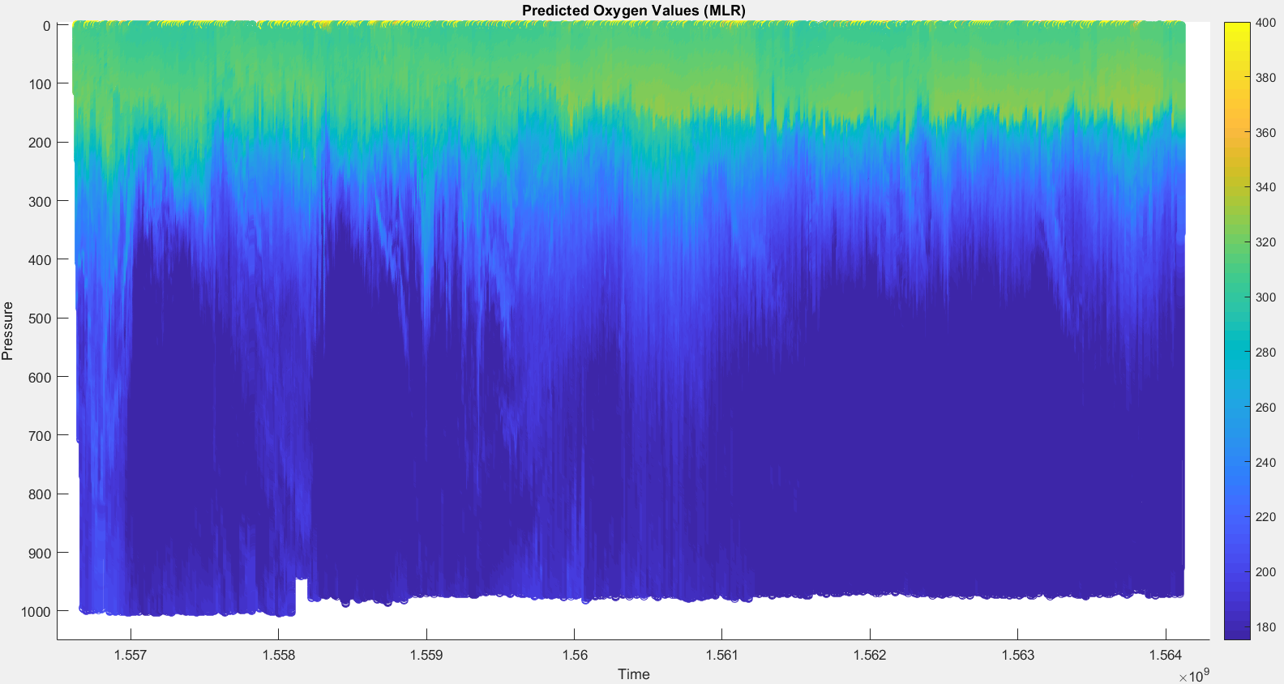
SG 659

Slide 19
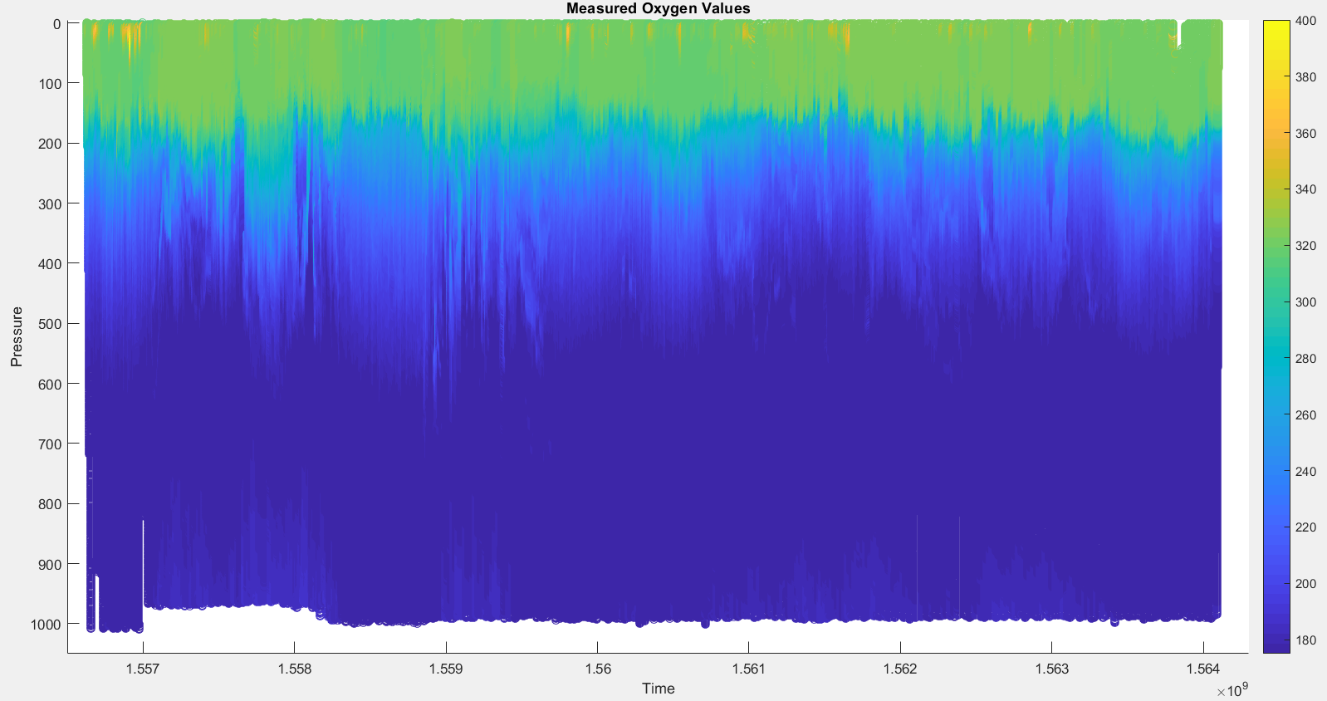
SG 660

Slide 20
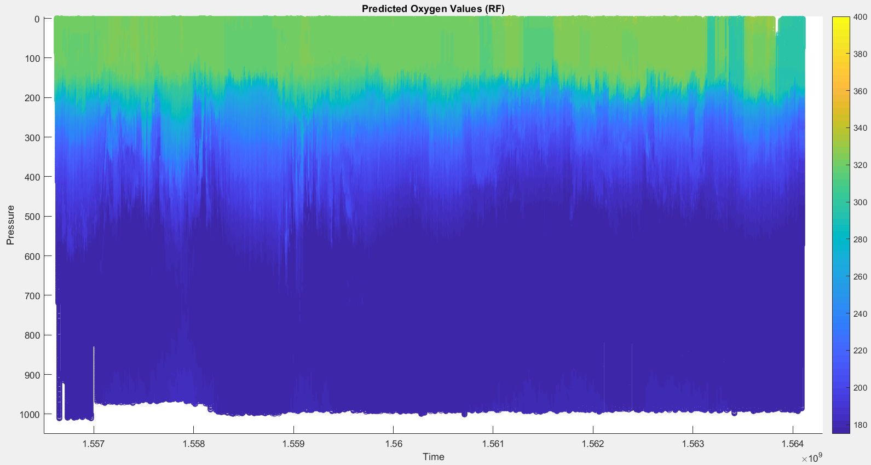
SG 660

Slide 21
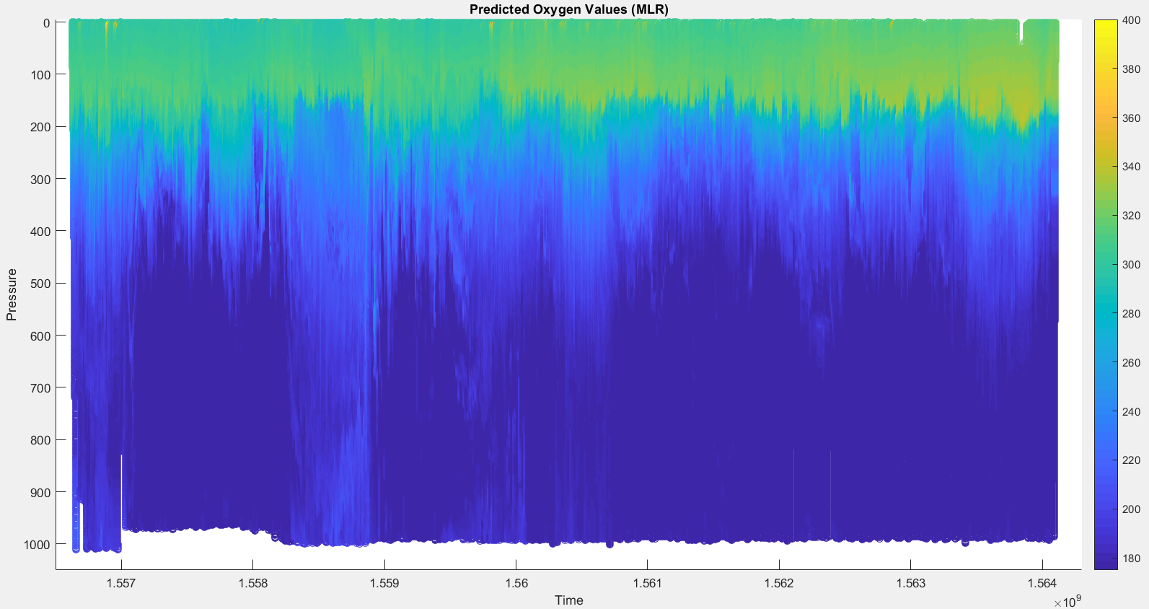
SG 660

